Slide 1

CSG1132: Assignment 1b
Literature Review
Julia Wexler
FHES Learning Adviser
j.wexler@ecu.edu.au

Slide 2
Overview
What is a literature review?
Writing process
Structure
Examples, activity, discussion
This is a discussion not a lecture—please ask questions/make comments as they occur to you!

Slide 3
Recap...
So far, you have:
gotten to know your topic
become somewhat familiar with the literature available and relevant themes through your concept mapping (assignment 1a);
begun to define your specific research questions and provisional thesis statements;
Now what?.... You need to write a literature review.

Slide 4
What is a literature review?
A review of current literature on a particular topic or issue.
A comparison of different sources.
An identification of ‘gaps’ in current research.
A critical evaluation and synthesis of the literature, NOT an annotated bibliography.
Your essay will join an on-going conversation about motivation in using social media, so you need to know what others have discovered/are currently exploring.

Slide 5
What is a literature review?
Your literature review should:
place your study in a historical perspective;
evaluate promising research methods;
define and limit the problem you are working on;
identify the ‘gap’ your research will fill.
...It also justifies why your essay should be written!
(Davies, 2011, p. 217)

Slide 6
Reading & researching tips
read and consider titles & abstracts first
use “key terms” and “subjects” functions
use discipline-specific databases to narrow your scope
don’t get lured in to informal/un-academic web sources
SKIM for what you need (don’t read carefully until you’ve committed to the text)
map your way
questions about reading for lit reviews?

Slide 7
Writing process
Define key sources
Look for scholarship that:
covers your general topic area;
has attempted to grapple with the various elements of your research question;
is of landmark importance in your topic area;
justifies your own research study.

Slide 8
Writing process
Critical review
Write down the article’s main ideas, themes, and conclusions.
Analyse these main elements and formulate criticisms, questions or doubts.
How is this source relevant to your own study?
Draft a brief summary of steps a, b, and c. Ensure you include the main idea of the study, evidence presented, your own criticisms, and a statement about the study’s relevance for your research.

Slide 9
Writing process
Compare and contrast
Identify similarities and differences in authors’ viewpoints.
Criticise and compare aspects of methodology.
Highlight outstanding and/or landmark studies.
Identify gaps in research, or areas that need to be examined further.
(Use colour-coding or another system to group sources together, or to track themes as they emerge.)

Slide 10
Writing process
Plan and draft
What is crucial for your readers to know in order to set up your own study and the questions you want to answer?
Start broad by outlining the general research area, then gradually narrow in on your specific topic area and questions.
Work towards identifying the ‘gap’ where your own study is positioned, and the justification for it.

Slide 11
Structure
Your Lit Review
Idea 1a
Idea 4+
Idea 4a
Idea 4b
Idea 2
Idea 1c
Idea 1b
Idea 3a
Idea 3b
Ideas read
during research are incorporated into your review, which explains how they relate to each other and your thesis statement

Slide 12
Structure
Introduction: introduces the topic area, its significance, the purpose of the literature review and how it will be structured (give the reader signposts so they know what is coming).

Slide 13
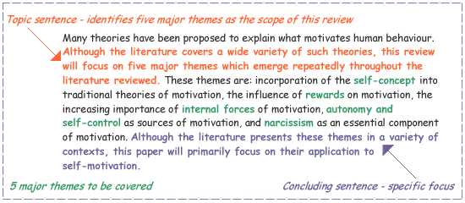
Intro example
(Study and Learning Centre, RMIT, 2005)

Slide 14
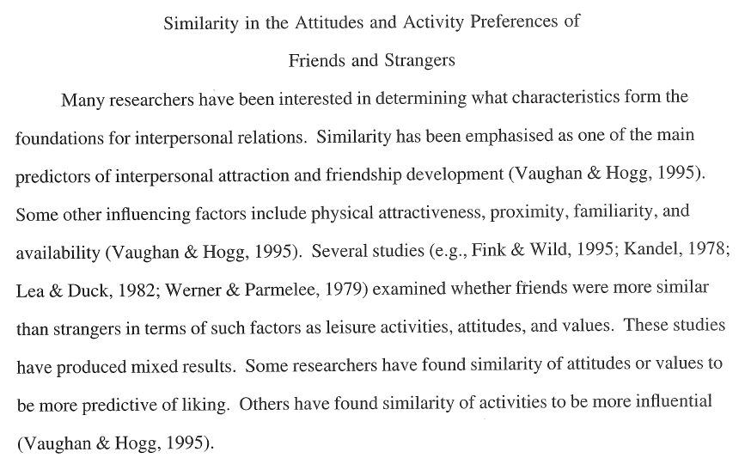
Intro example
(Burton, 2010)

Slide 15
Structure
Body: divided into sub-sections. Each section will contain your critical reviews synthesised together into separate paragraphs, each with their own topic sentence, body, and concluding sentence. Select relevant parts of your critical review summaries and weave them together into your literature review ‘story.’
Conclusion: restates the purpose of the literature review and briefly summarises the position of the main research aim in relation to current scholarship.

Slide 16
Vocabulary to indicate structure
“While Jones (2002) argues ... Smith (1999) claims that...”
“Smith (1999) and Jones (2011) both showed that ... However, Hutchison (2002) demonstrated that ...”
“Early marketing theory owes its development to ... Many studies contributed to ... for example, Jones and Smith (1986). Hunt (1987) was recognised for ... but later Jamison (1999) showed that ...”
(Davies, 2011, pp. 220- 221)

Slide 17
Explore examples provided
Identify the topic of each paragraph & observe how sources have been woven together w/in each paragraph.
Underline structural vocabulary specific to lit reviews.
Examine how the choice of sources has been guided by the themes identified.
Try to find the transitions—indicate them with a *.
Note the different scope of each example—which one type of organisational structure might you use as a model for your own lit review?
If there’s time, begin drafting your own intro, using themes identified in your concept mapping assignment.

Slide 18
Marking key

Slide 19
FHES Academic Skills Workshops
FCHS Academic Skills Workshop topics include:
Reading and Note-Taking
The Academic Writing Process
Paragraph and Sentence Construction
Thinking Critically & Building Arguments
Referencing and Paraphrasing
Writing Essays, Literature Reviews, and Reports
.
Please go to the “Workshops” section of our “FHES Academic Learning Support” Blackboard community site to register (in the “My communities” column under your units on Blackboard).
Or follow the link at ecu.edu.au/fheslearning

Slide 20
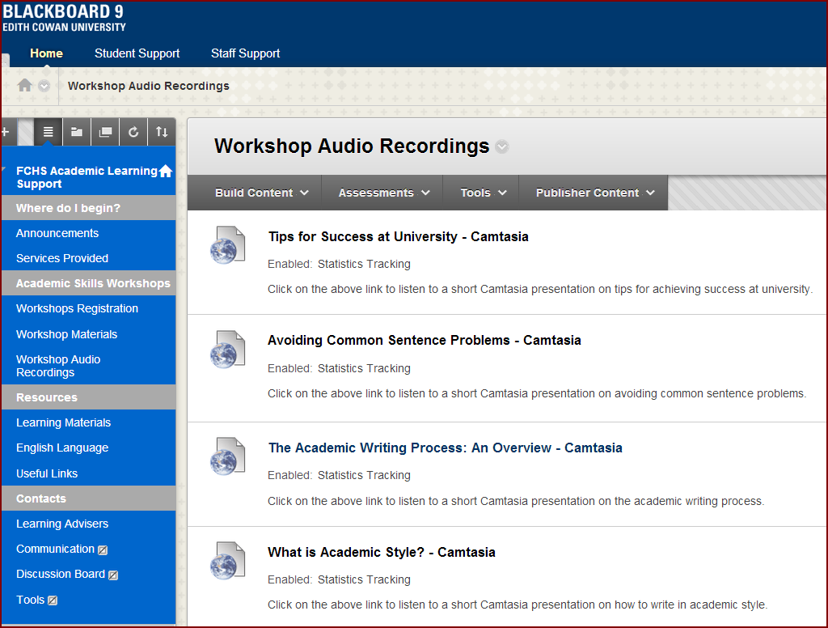
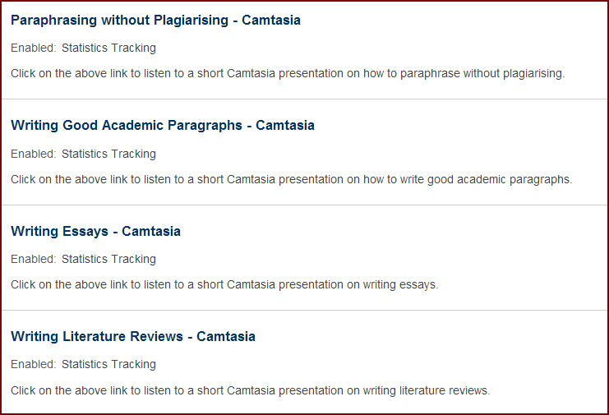
Assessment-Related Workshops
ML Building 15, Room 206 ⬅⬅

Slide 21
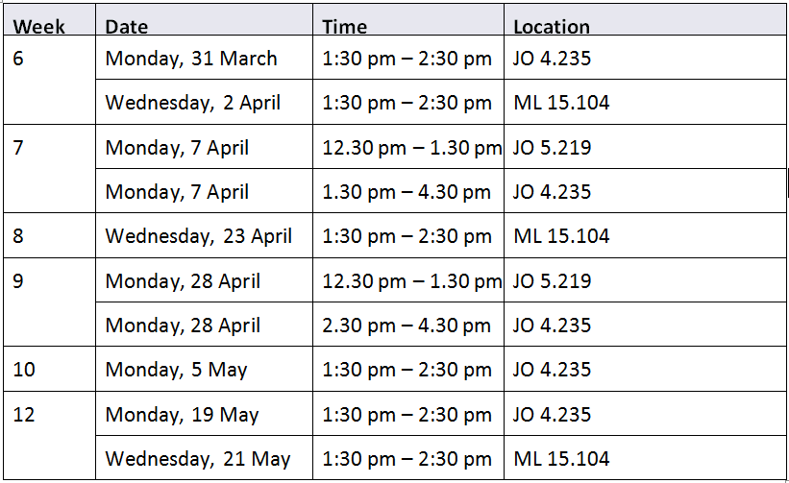
Assignment Drop-In Labs
Or email Julia at j.wexler@ecu.edu.au

